Slide 1
Intro to Computer Science
9th & 10th Grade, Fall 2026

Slide 2
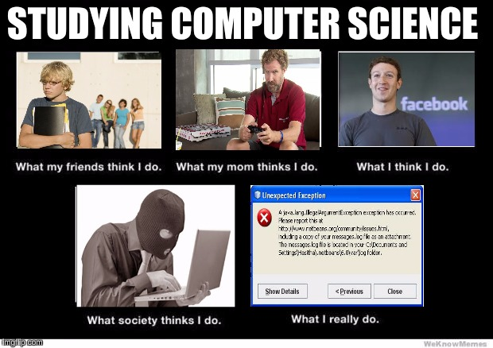
What can I expect in Intro to Computer Science?
Overview of the broad field of Computer Science
Lots of different topics covered quickly
Start of a pathway that can lead to future opportunities

Slide 3
Class Overview
Unit 1: Computing (3 weeks)
Unit 2: The Internet (3 weeks)
Unit 3: Python Programming (6 weeks)
Unit 4: Artificial Intelligence (2 weeks)
Unit 5: Game Development (5 weeks)

Slide 4
AI Policy
Guiding principles
AI is not going away and is an important tool.
AI can also be a hindrance to learning critical skills and reduces cognitive load.
AI cannot fully automate human tasks.
We will learn about AI in this class, but I ask that you refrain from using AI tools unless you are specifically given permission to do so on a assignment.

Slide 5
STEM Certificate Pathway
Students who earn 30 credits in a STEM field are eligible to earn a certificate in a STEM field including Computer Sciecne
Intro to Computer Science
AP Computer Science Principles
AP Computer Science A
+Math classes & clubs

Slide 6



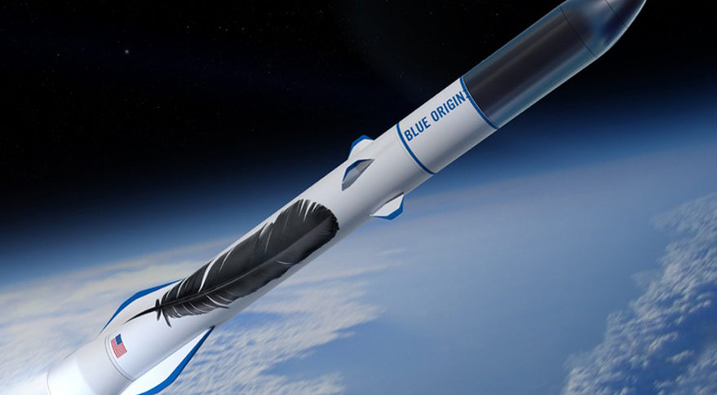
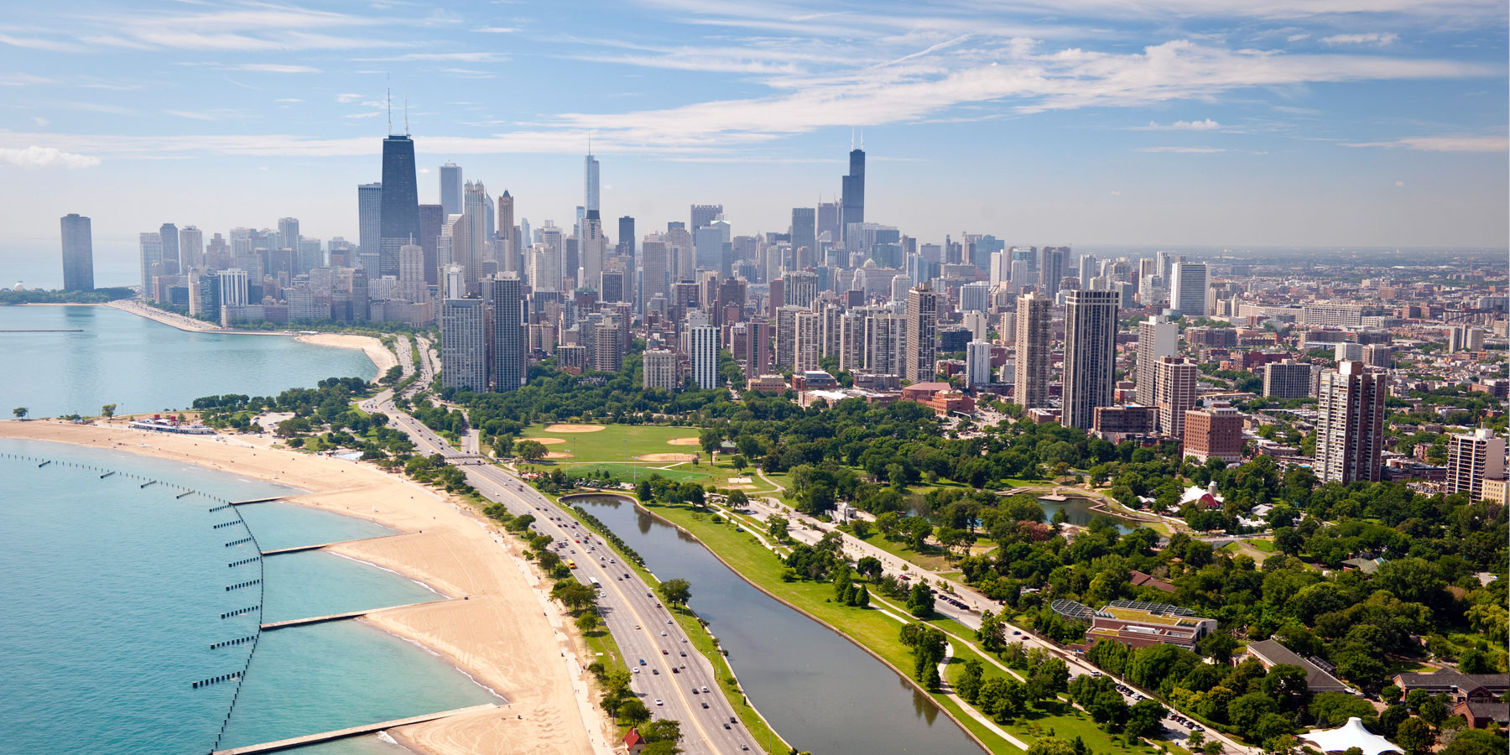
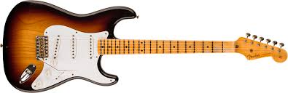
About Me

Slide 7
Role Call
Your name
What are you are most excited about learning in this class?
What is 1 highlight from winter break (or last semester)

Slide 8
Class Activity
Computer Science Trivia
https://jeopardylabs.com/play/technology-1691

